Slide 1
AD-BC-VUMPS

Slide 2
Contents
Why AD?
AD-VUMPS
big cell
AD-BC-VUMPS

Slide 3
Why AD?

Slide 4
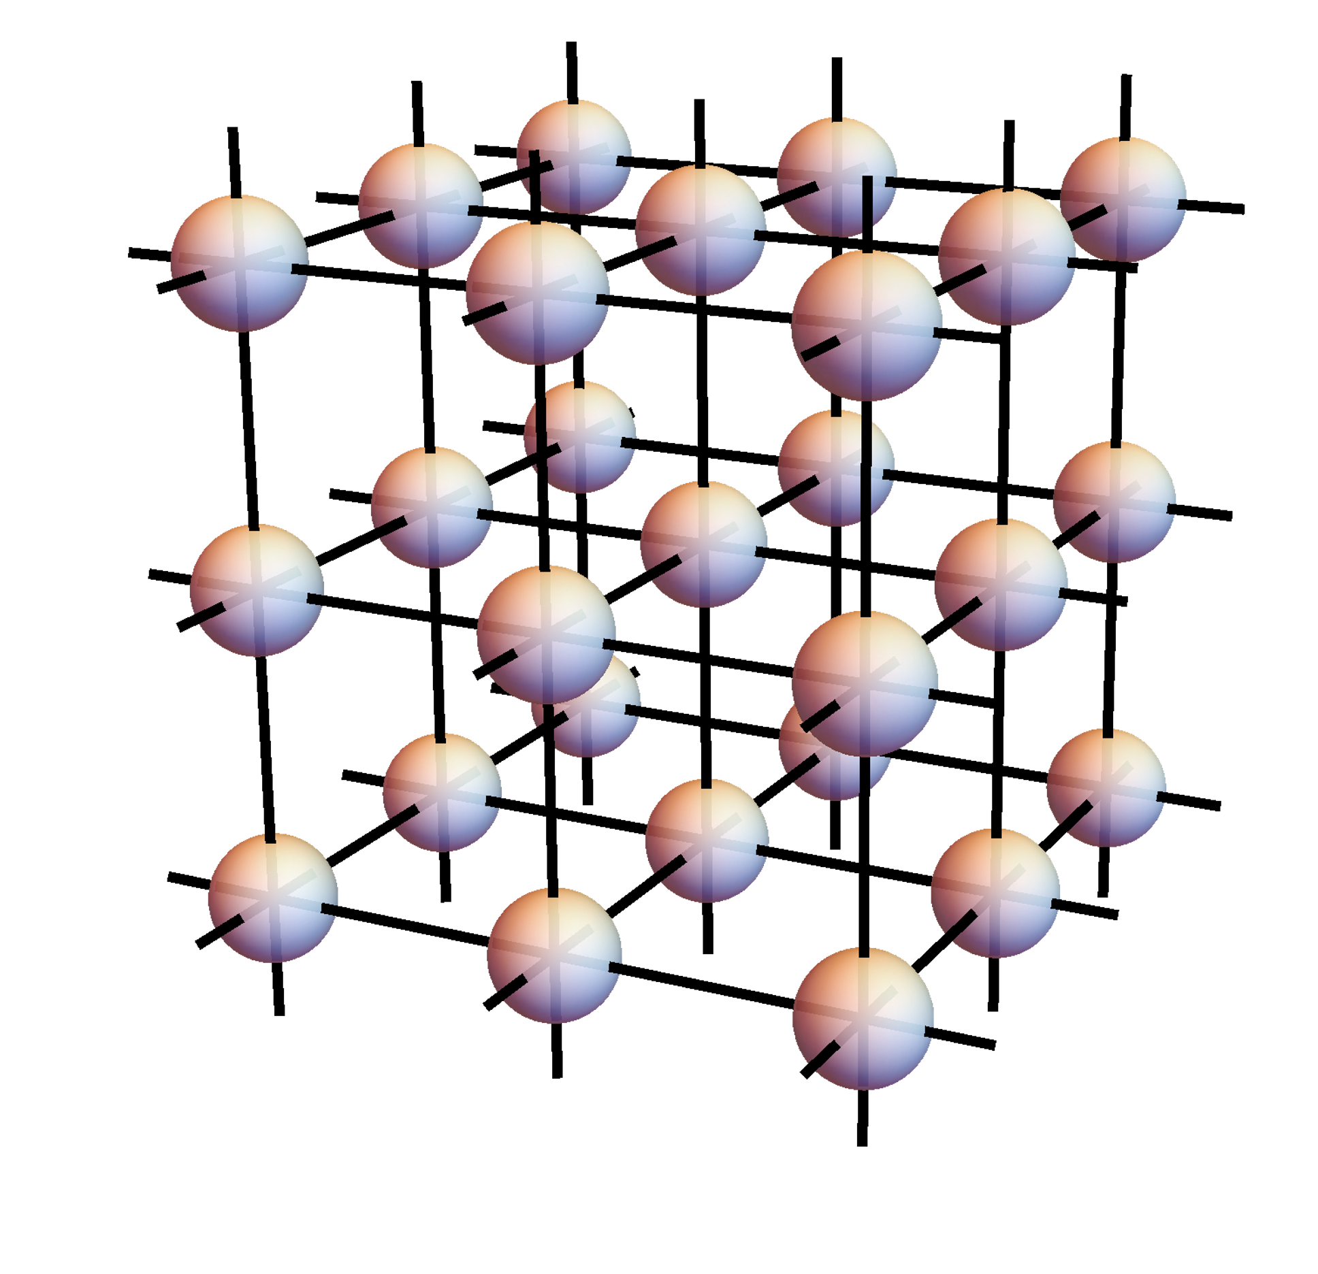
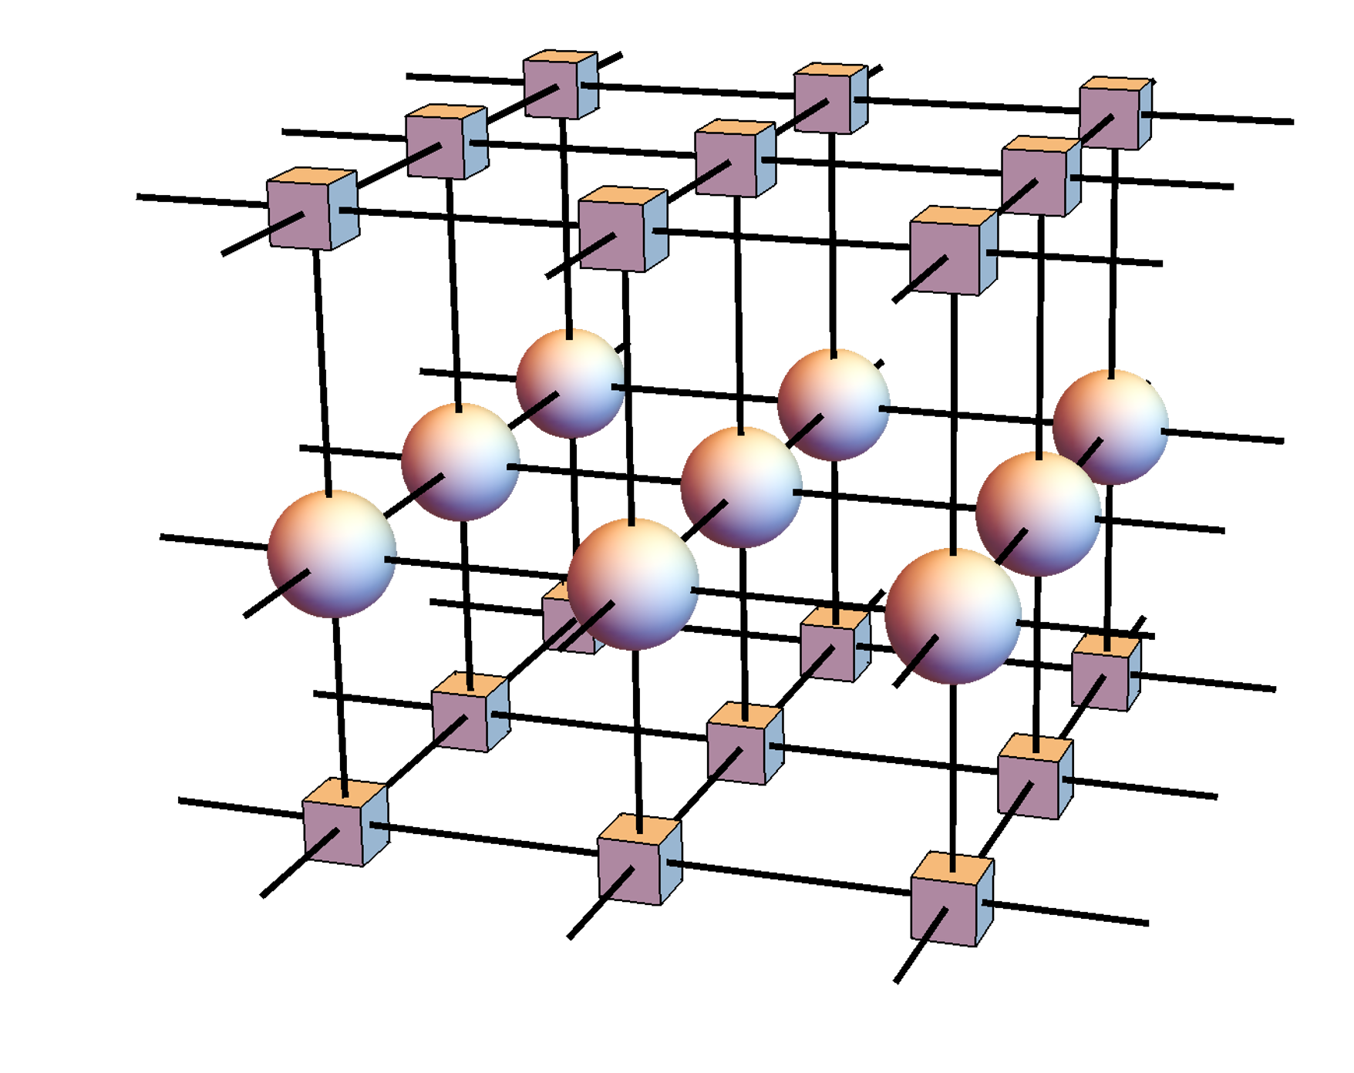
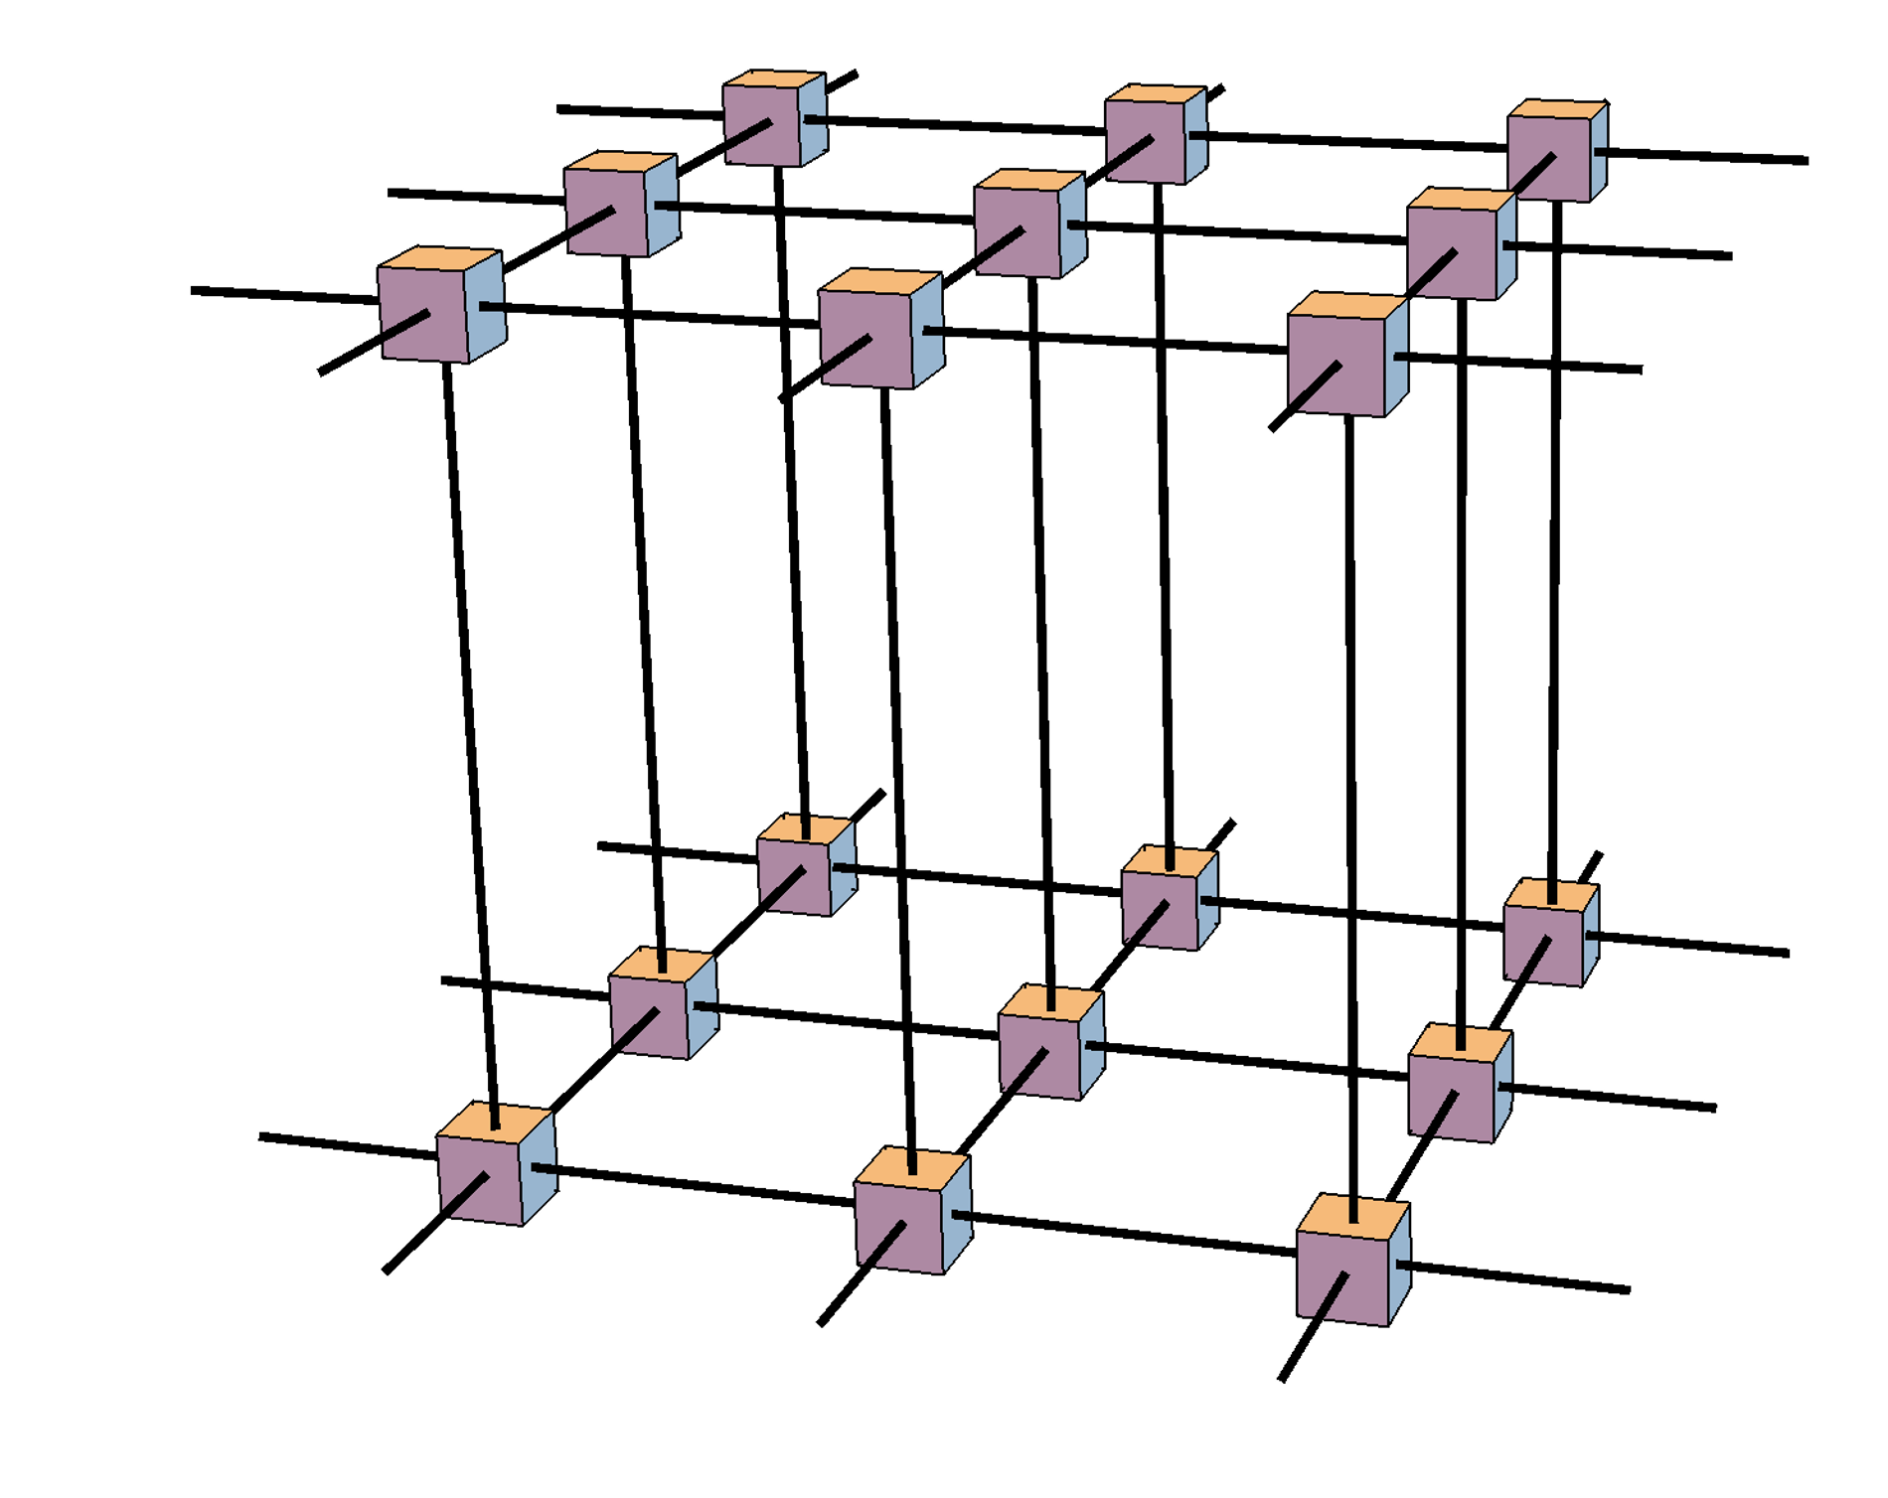
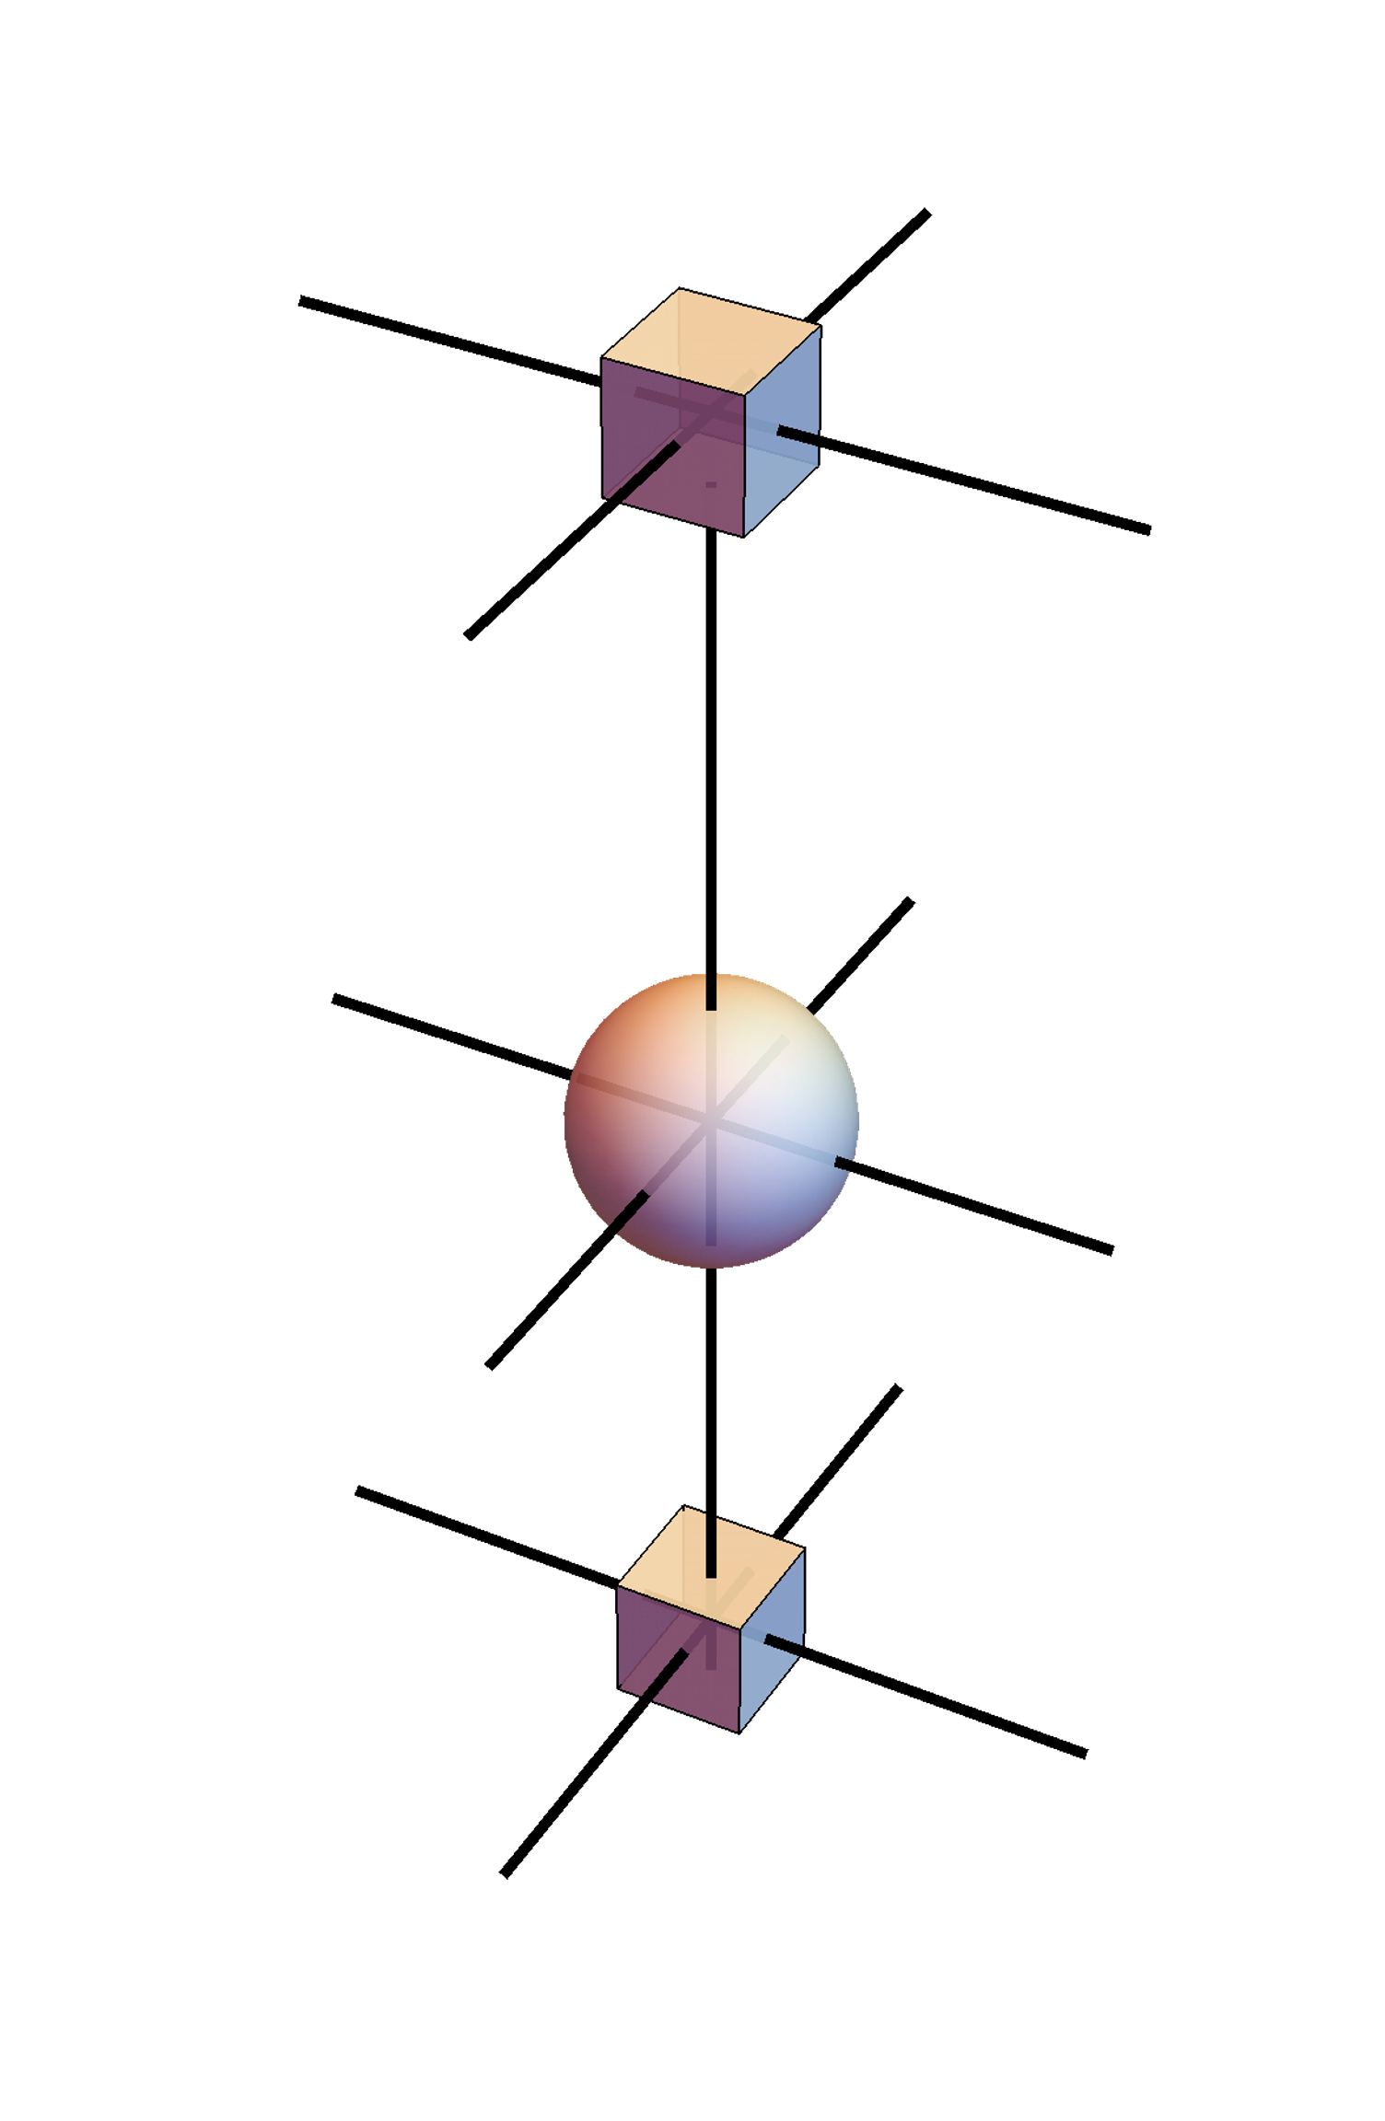
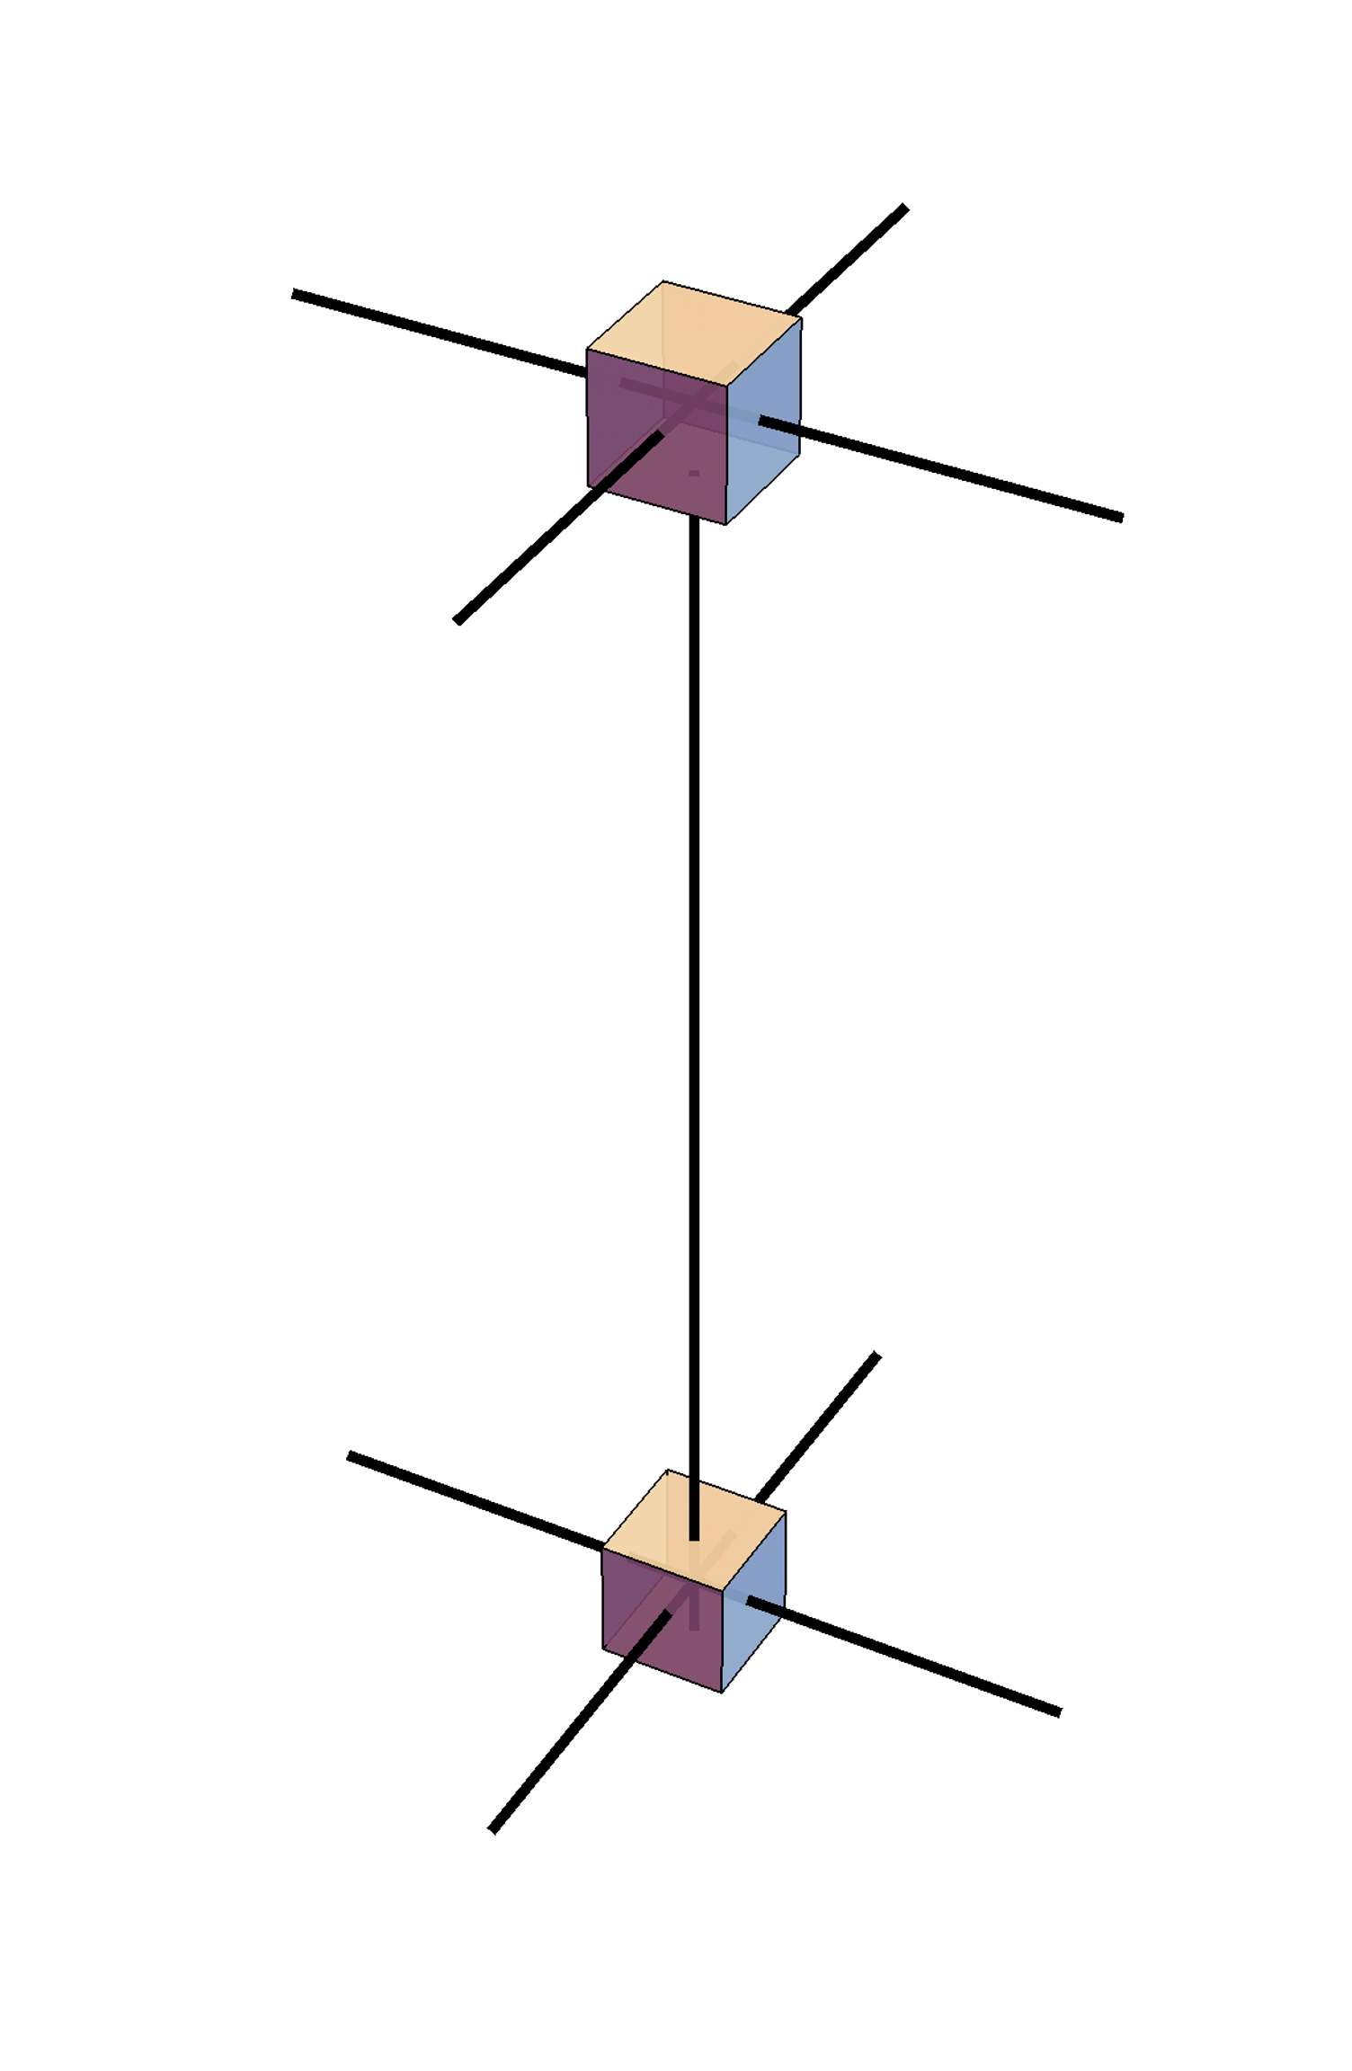
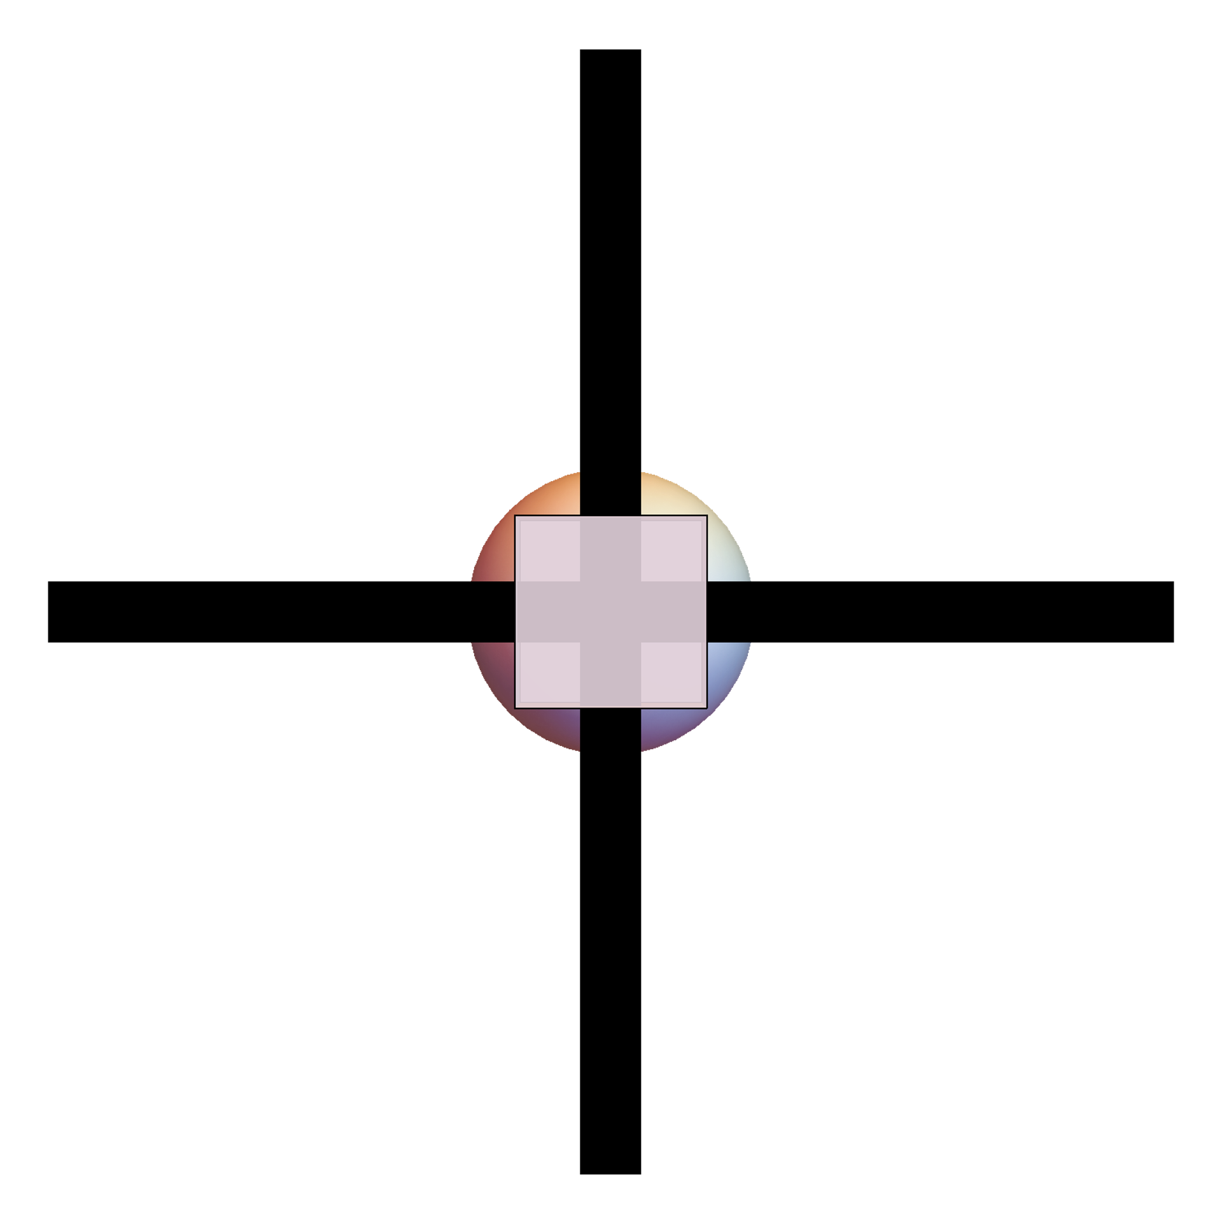
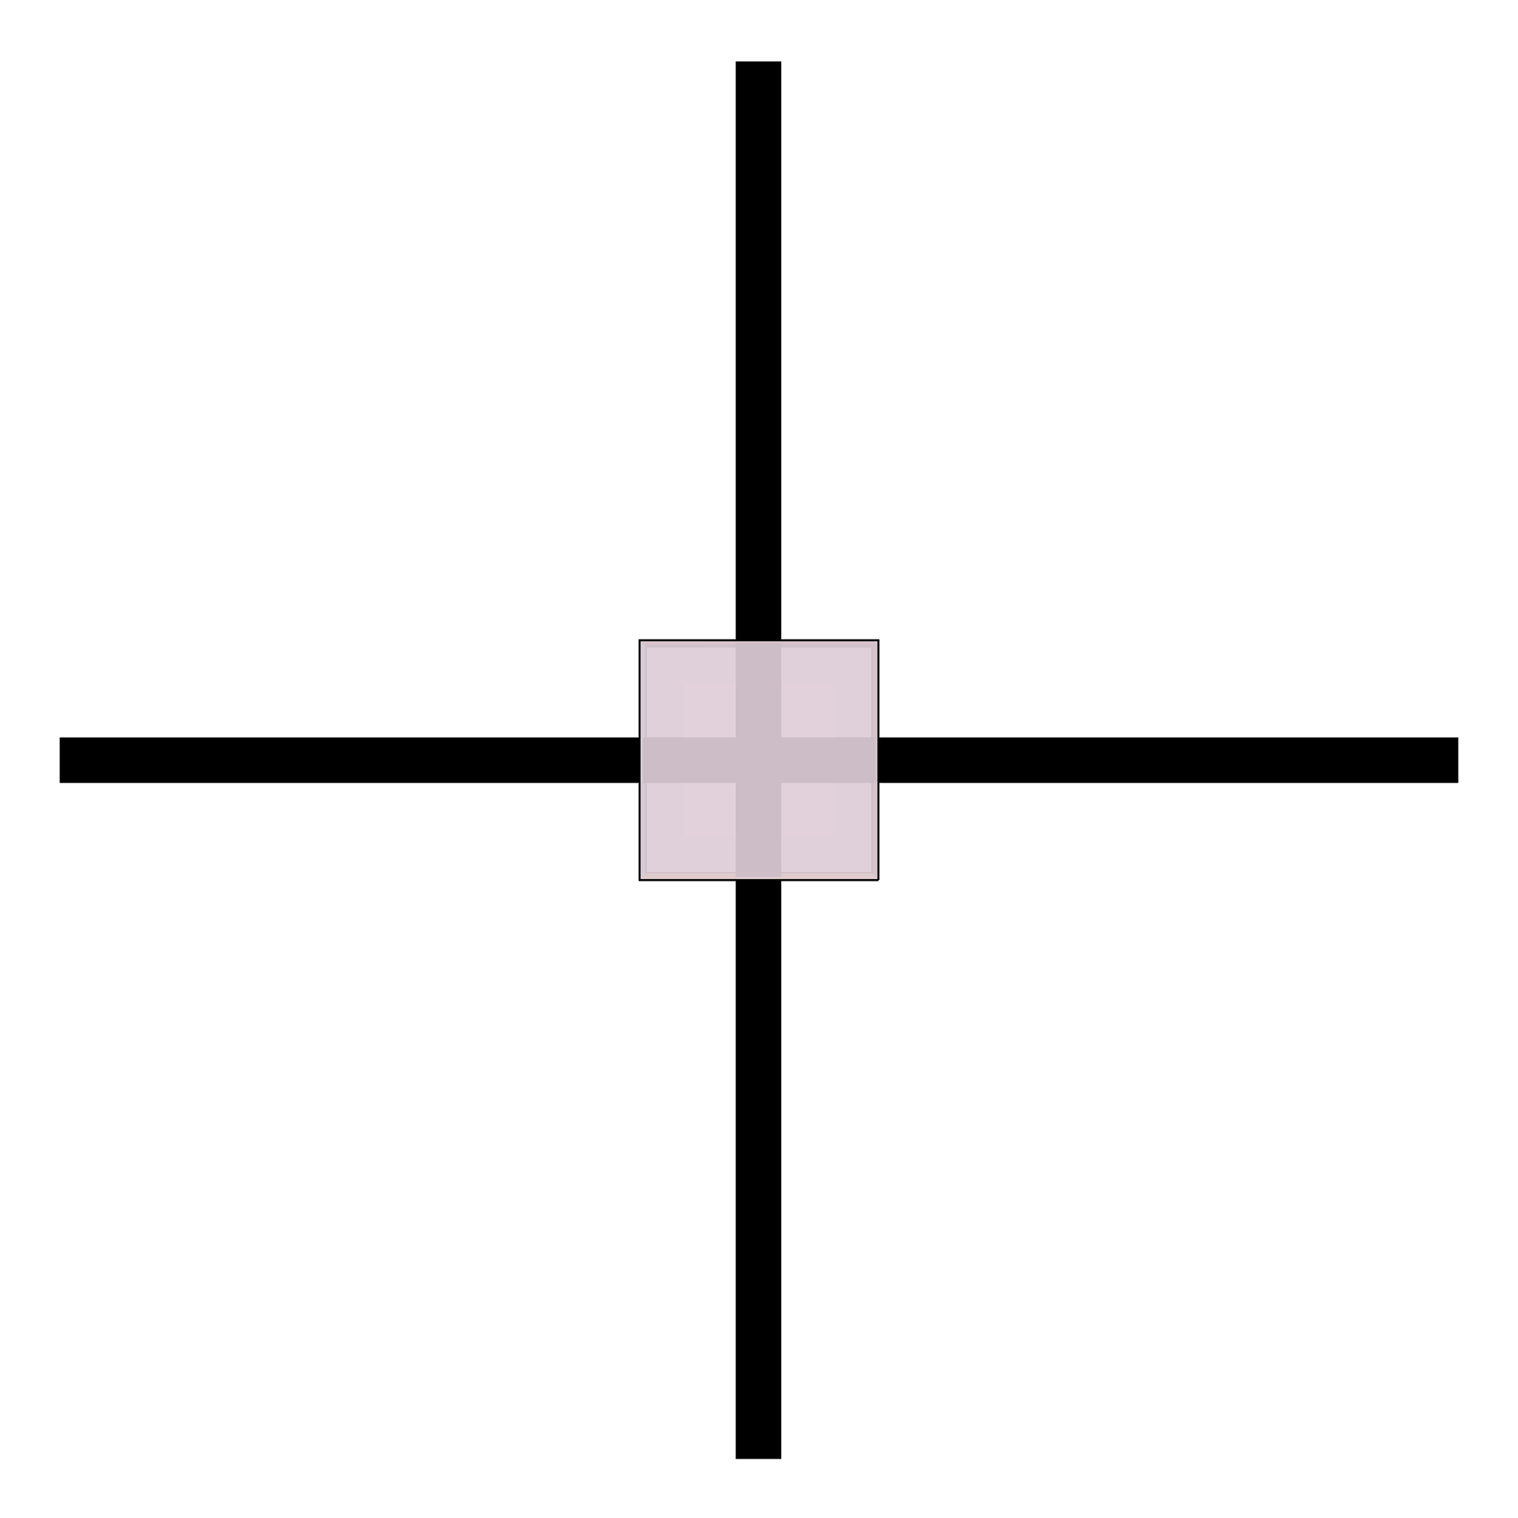

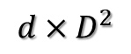
3D ising contract
PEPS
Z =
=
/
single
z =
A
D
D
$$d×D^{2}$$
$$D^{2}$$
contract to 2D
M
/
/
d
M1
M2
A
D
D

Slide 5
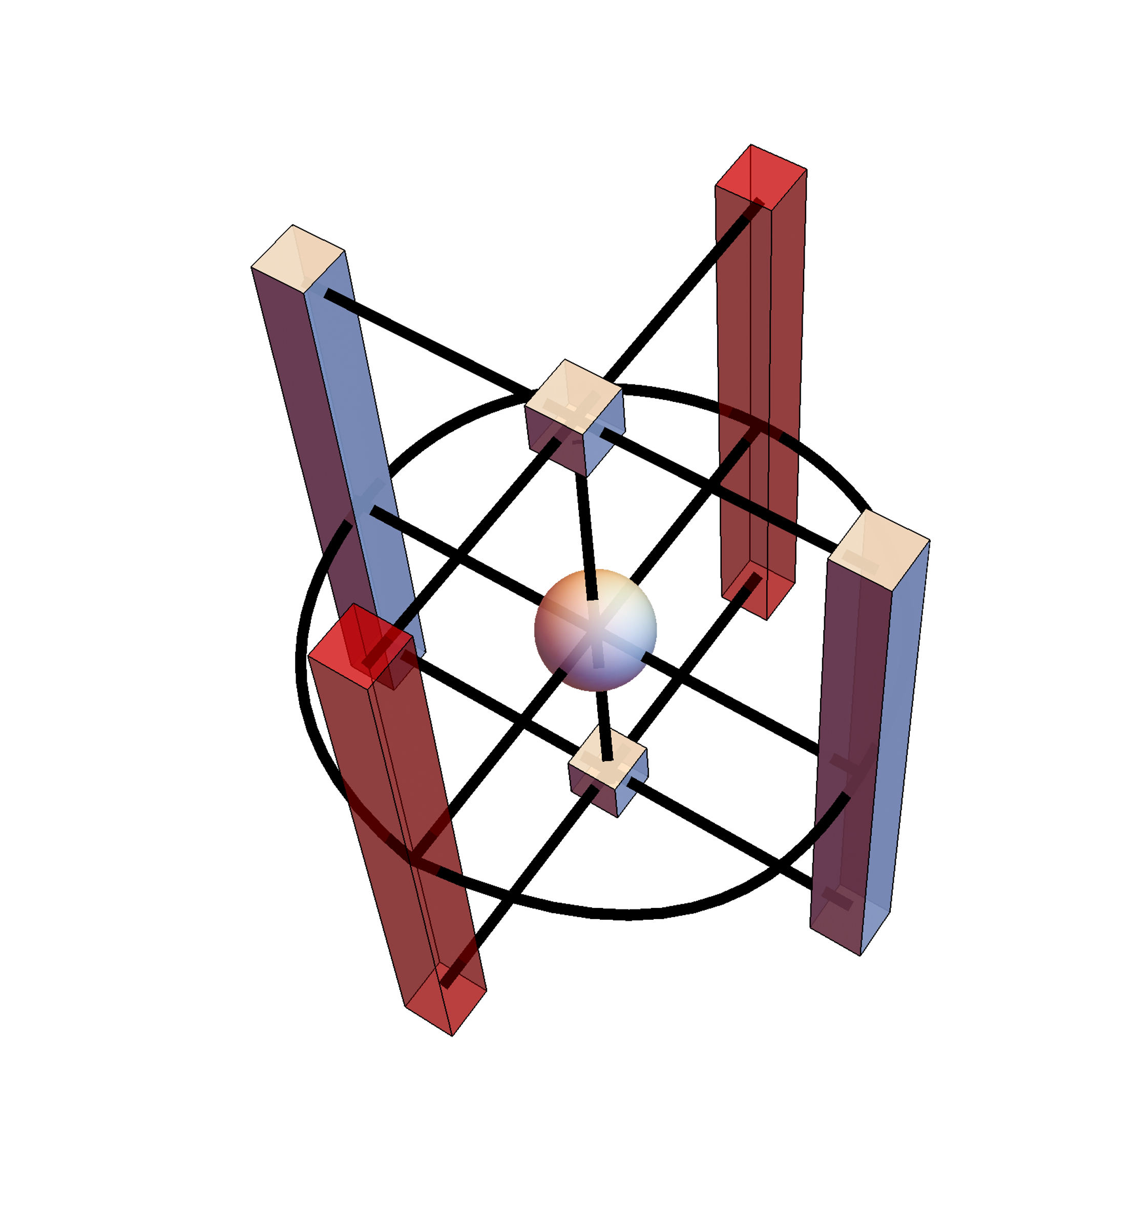
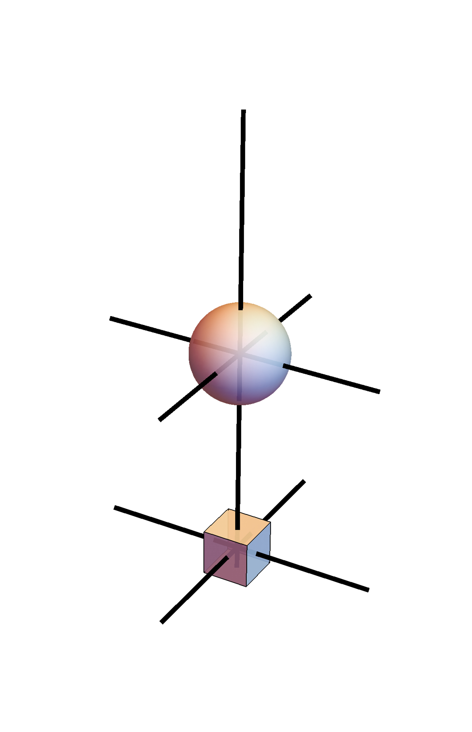
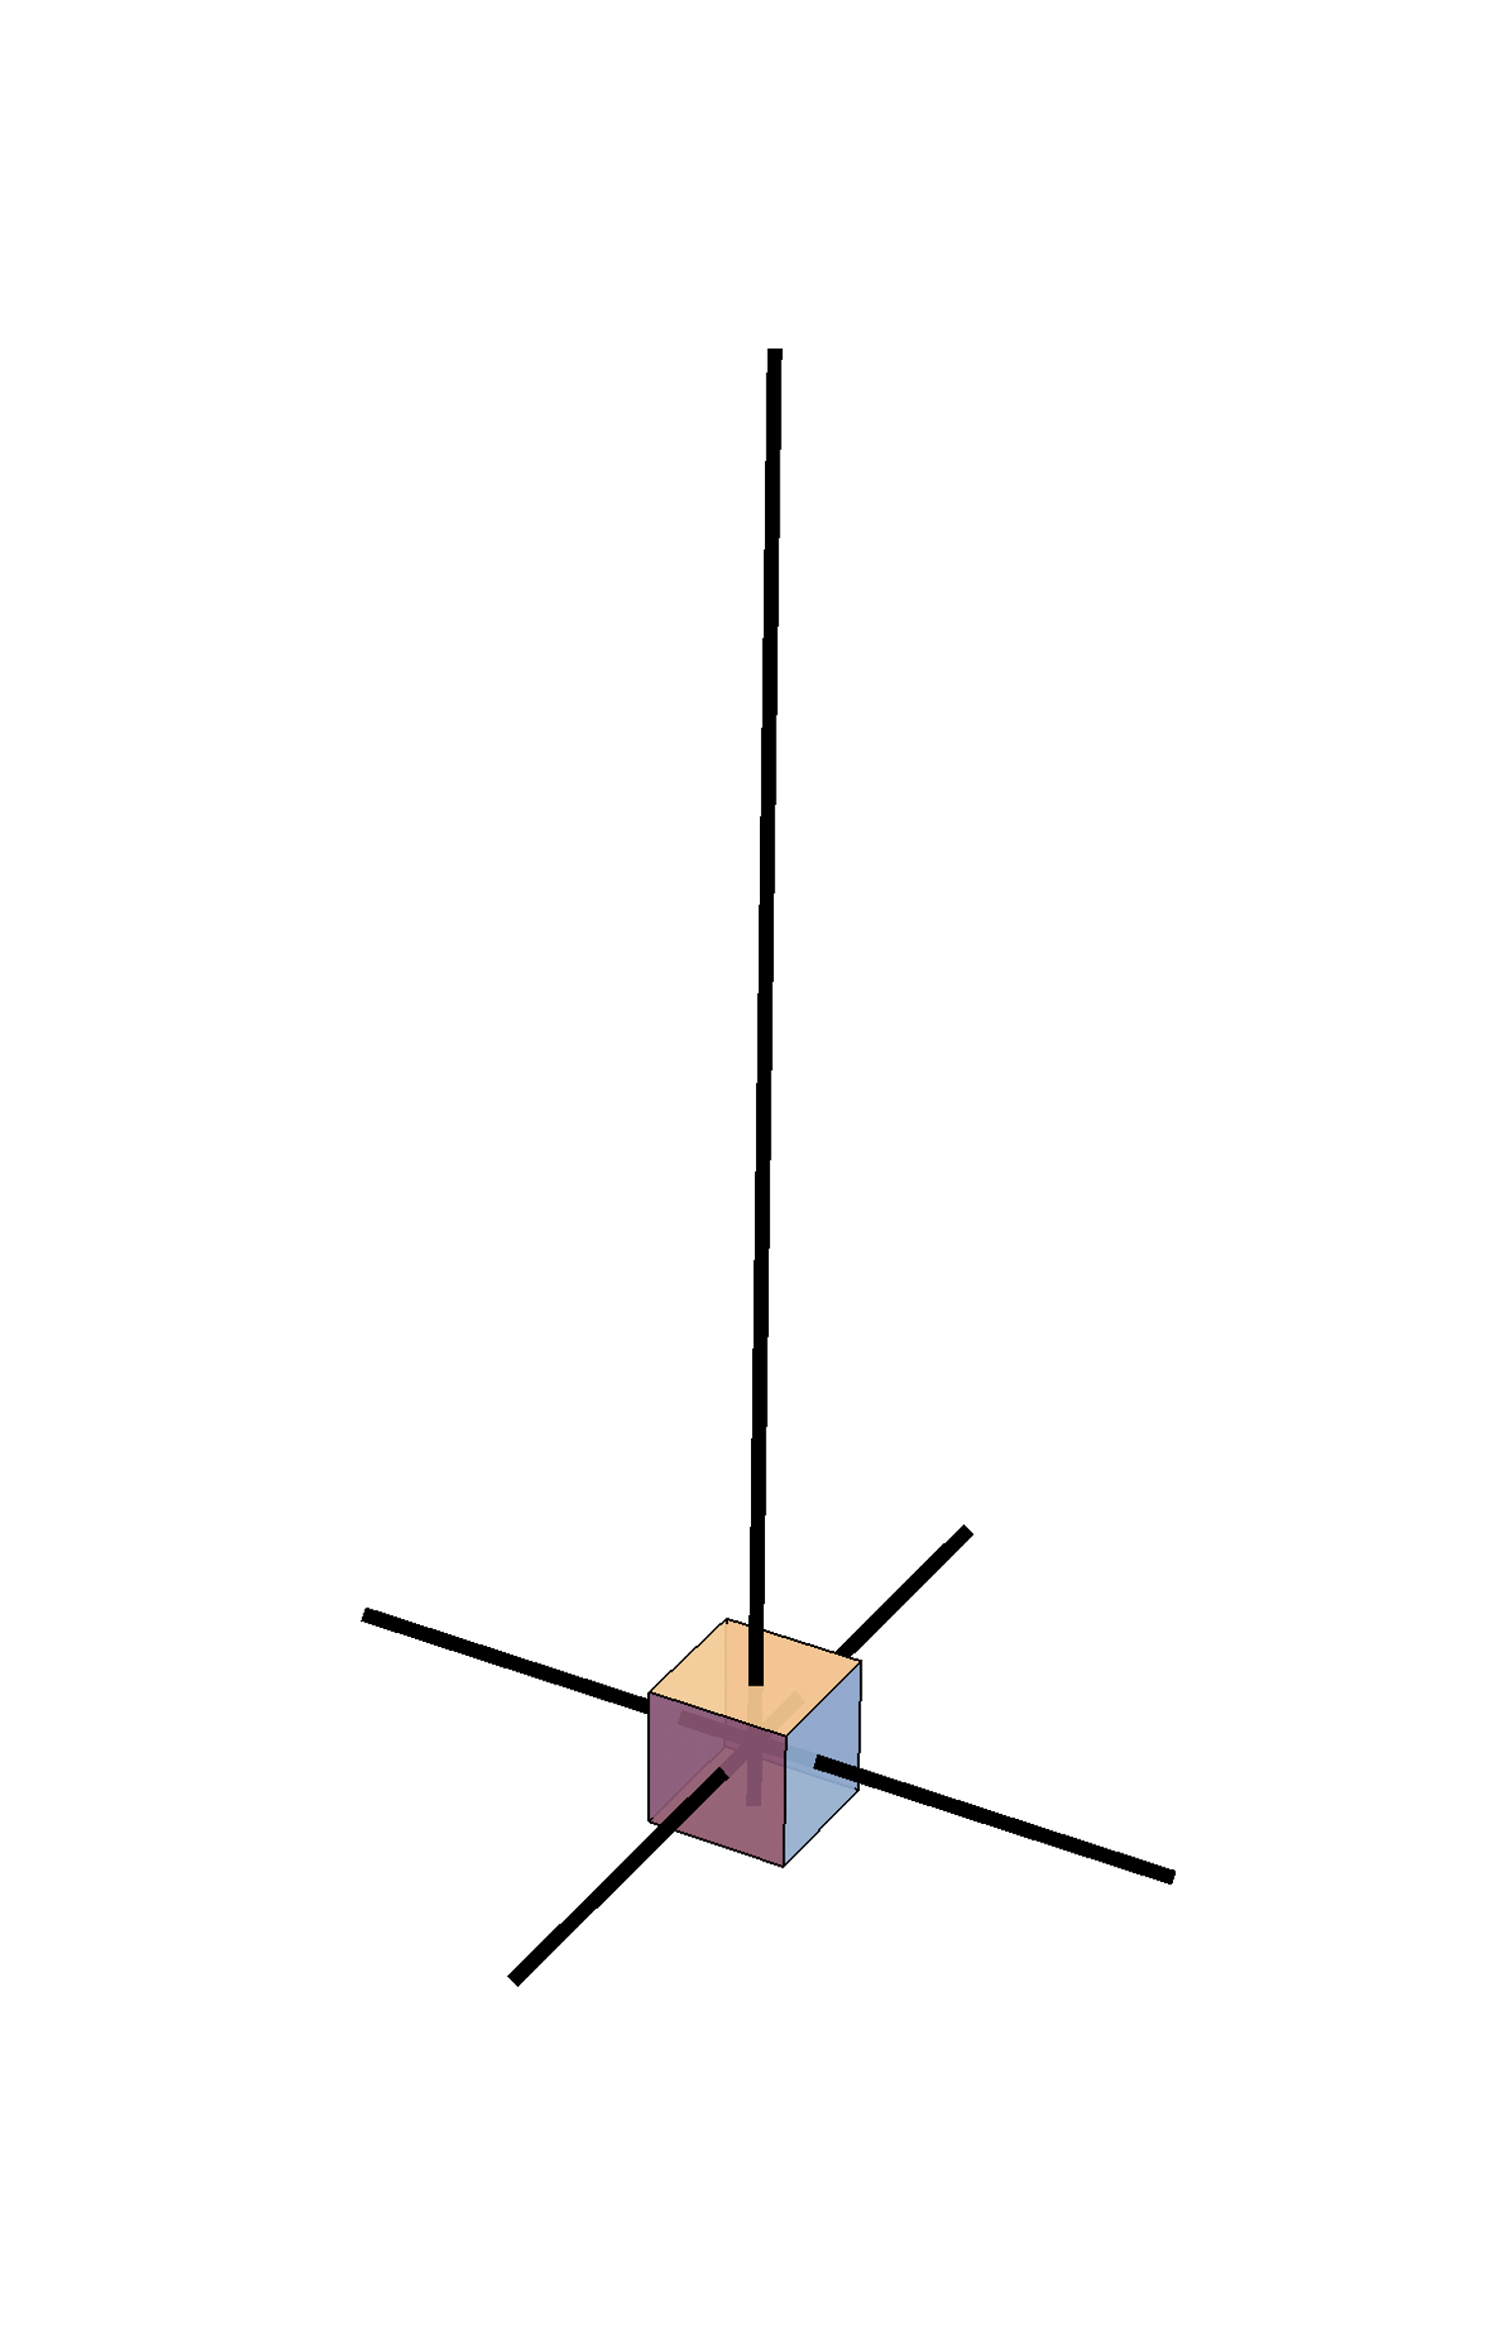
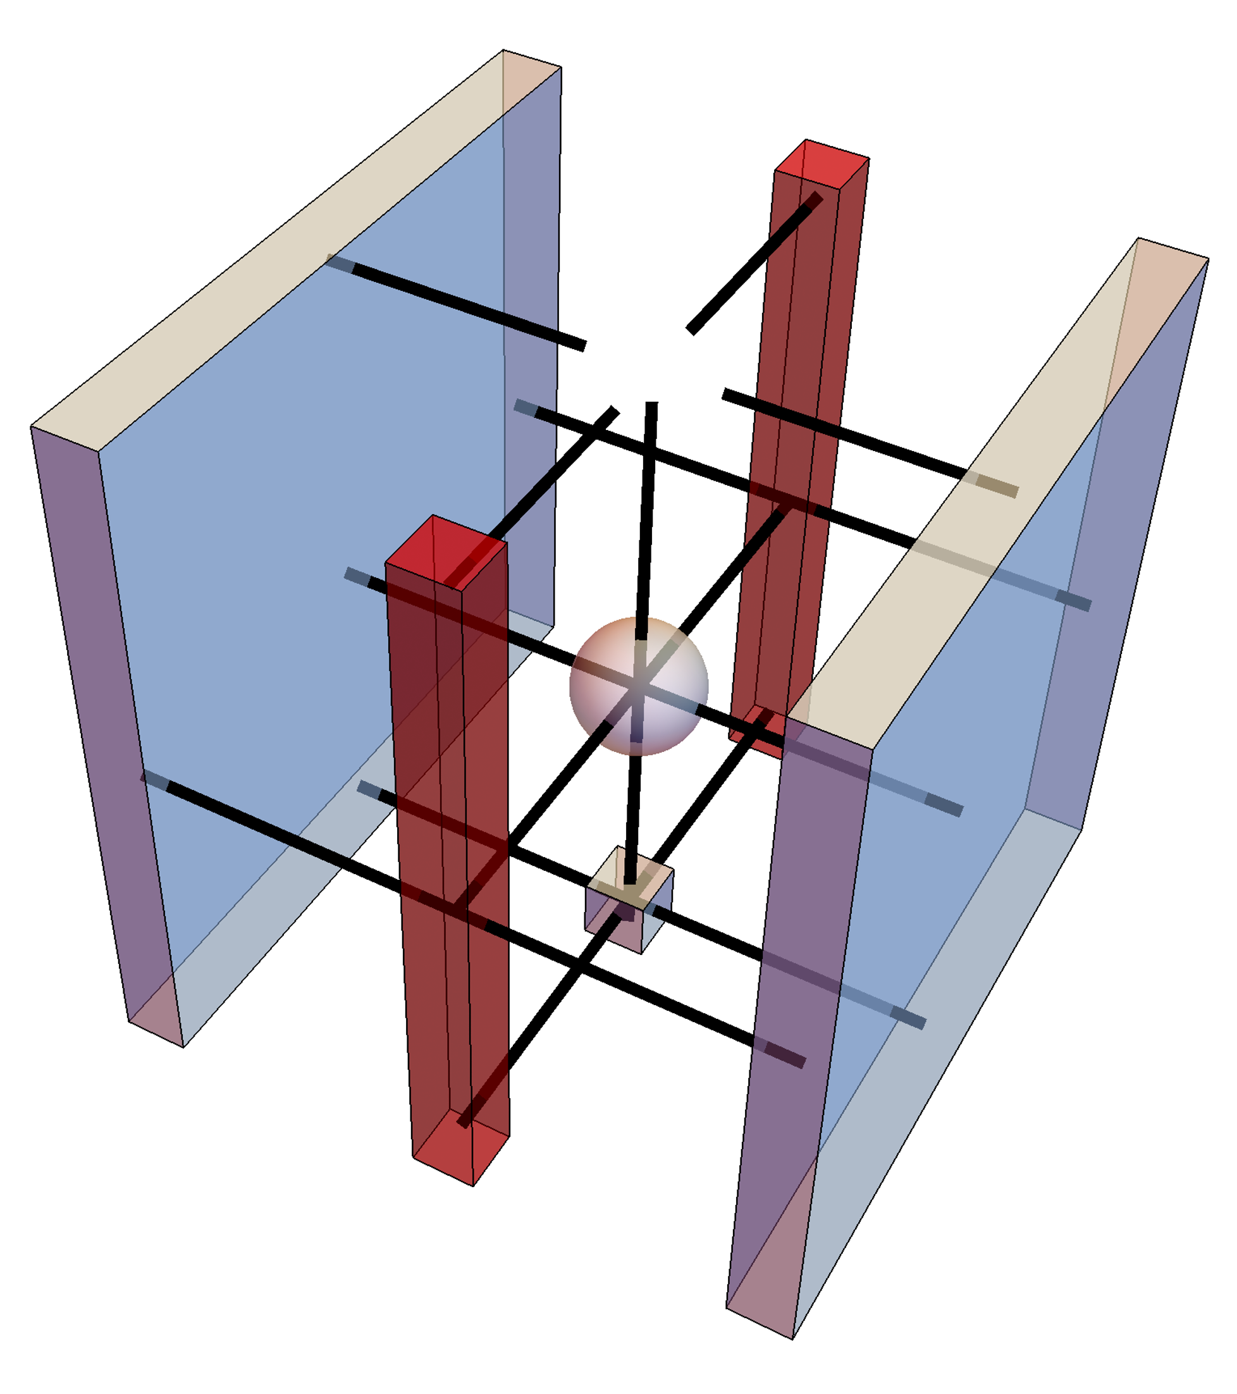
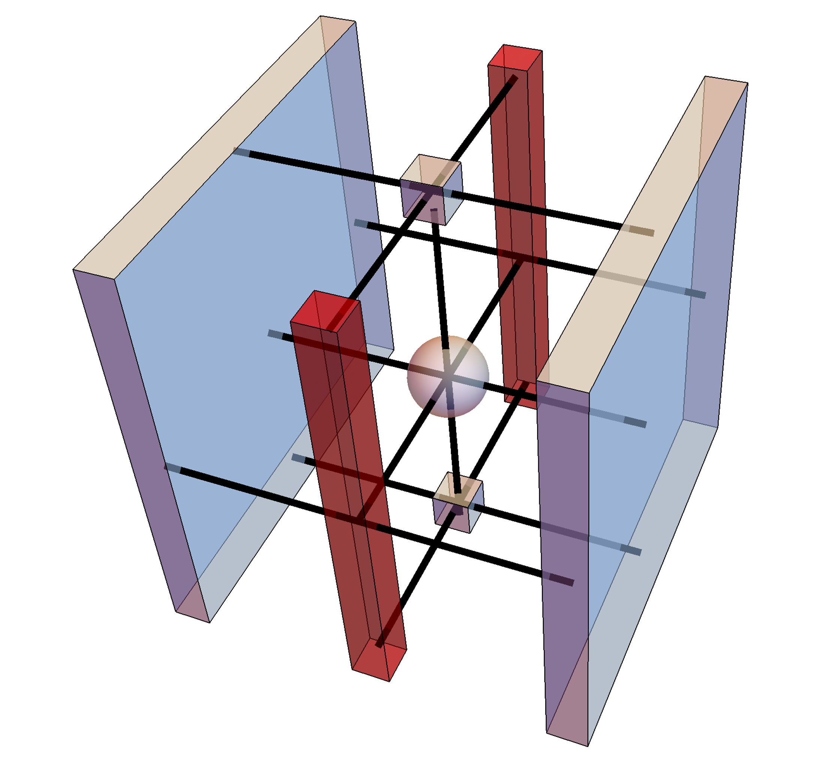
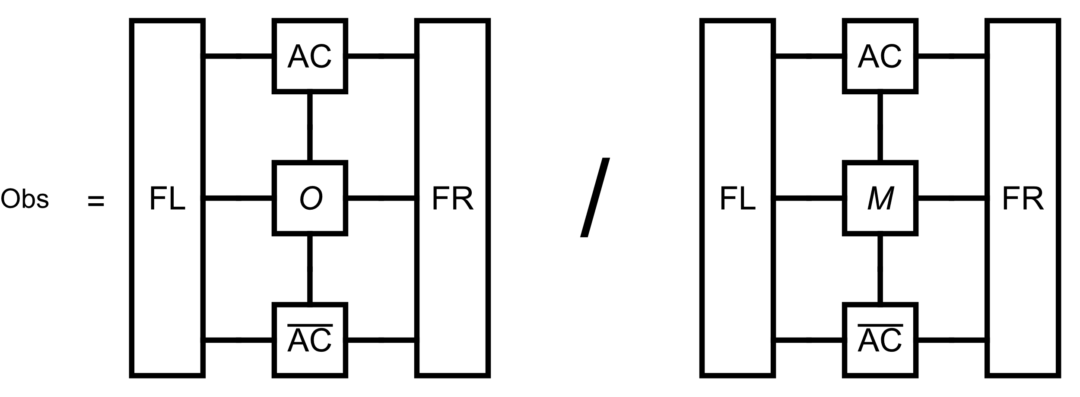
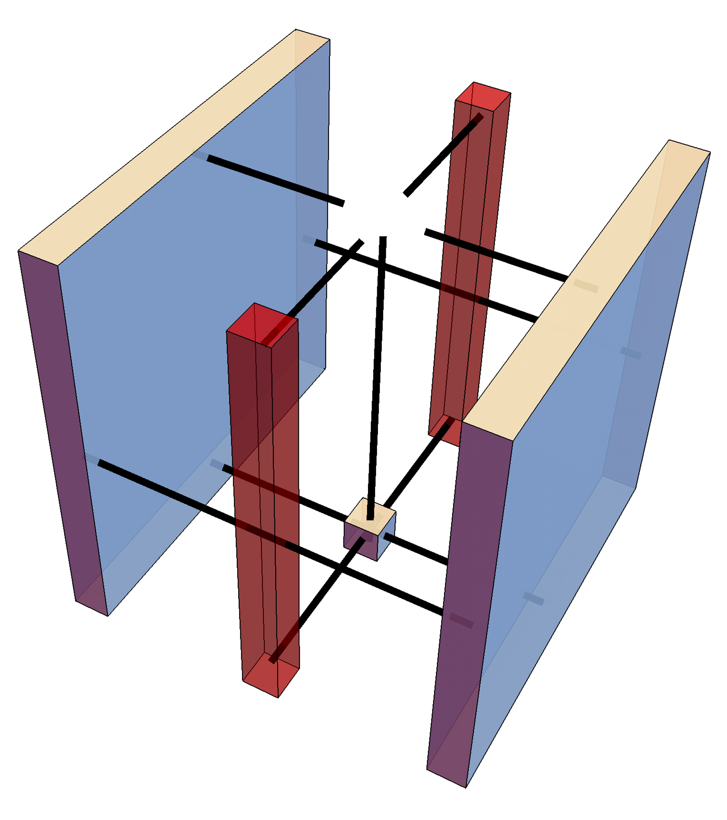
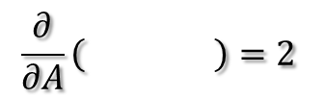
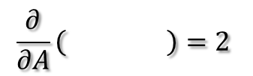
Gradient to and
$$\frac{∂}{∂A}\left( \right)=2$$
$$\frac{∂}{∂A}\left( \right)=2$$
3D view
add envir

Slide 6
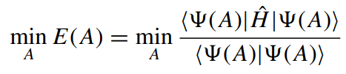
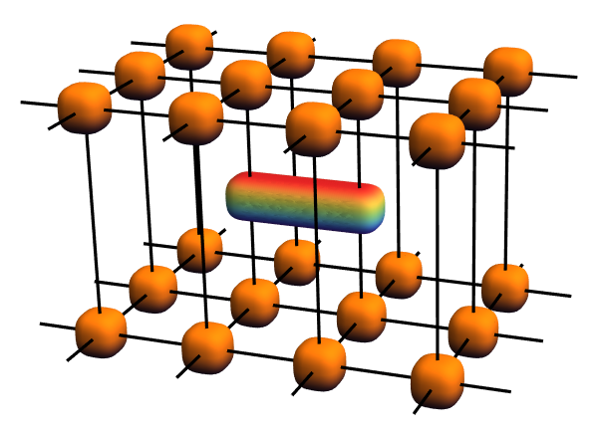
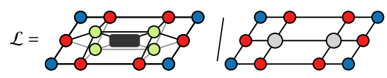
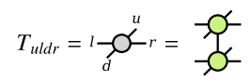
Quantum case
2D Energy

Slide 7
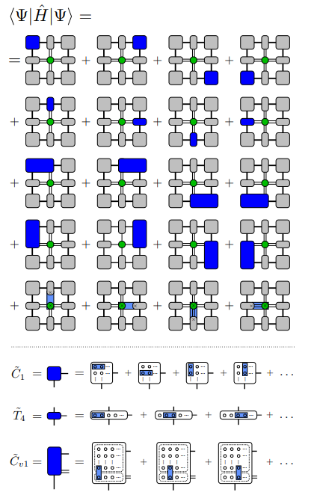
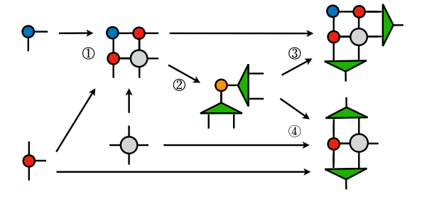
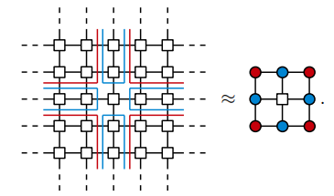
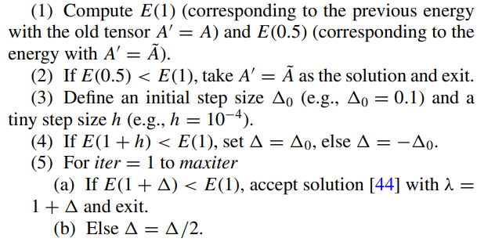
CTMRG
Experimental optimization method

Slide 8
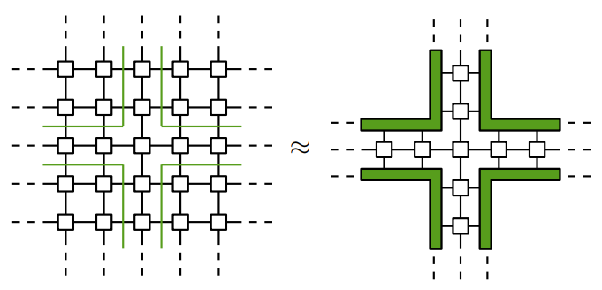
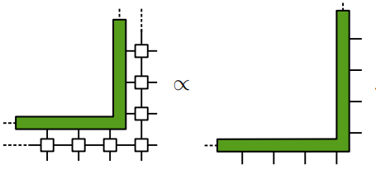
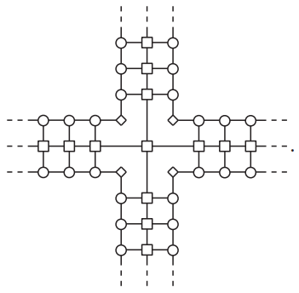
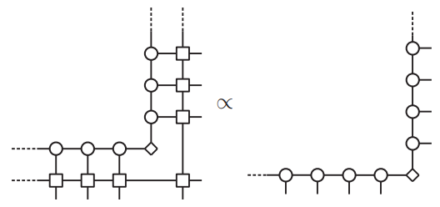
Channel environments
Fixed-point
MPS approximate

Slide 9
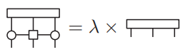
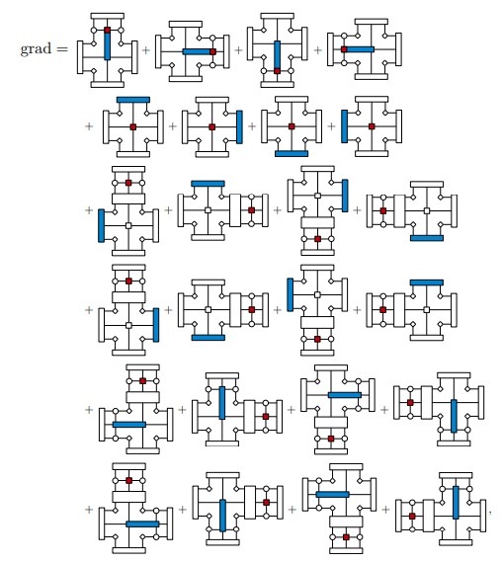
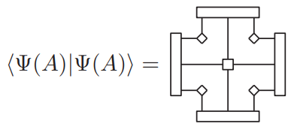
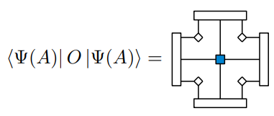
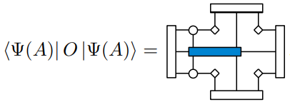
Gradient
overlap
observable
two-site

Slide 10
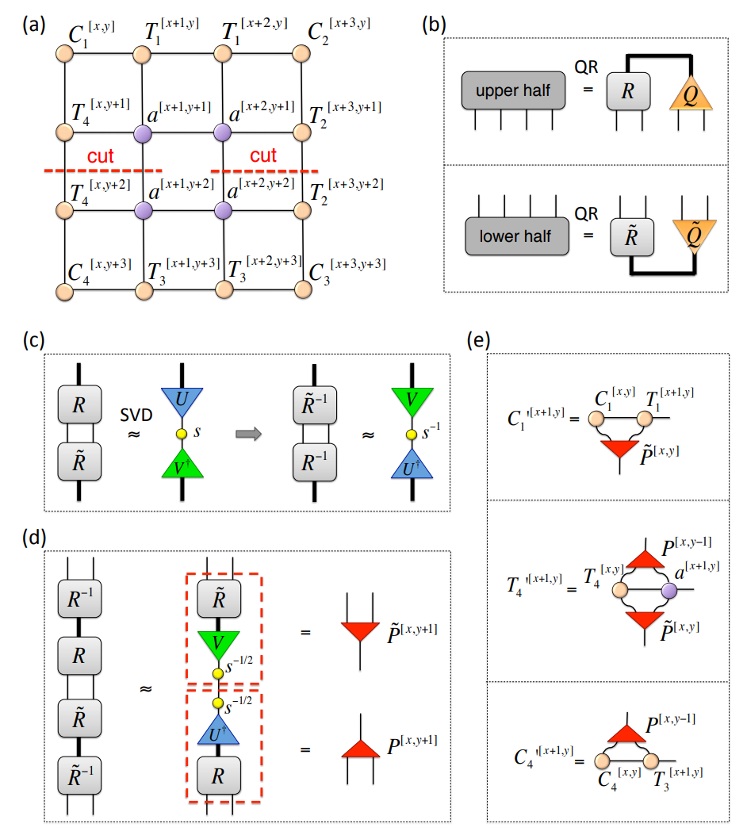
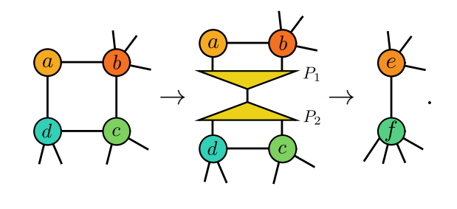
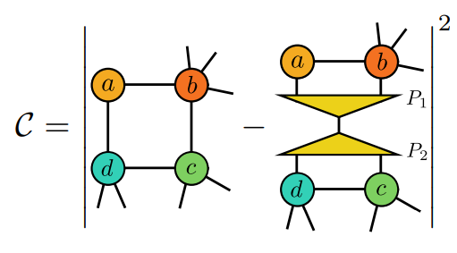
Big Cell CTMRG
General case
minimize the norm

Slide 11
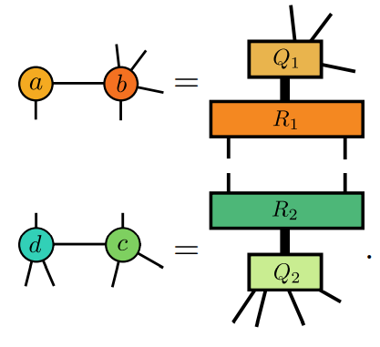
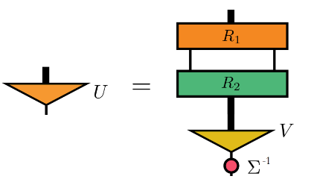
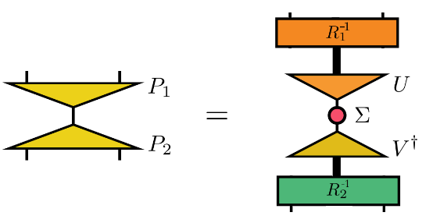
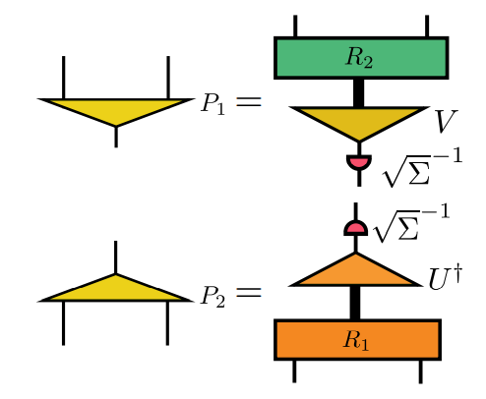
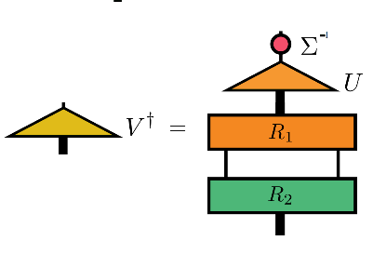
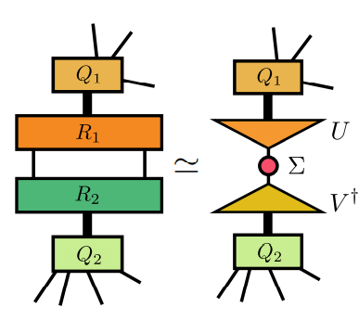
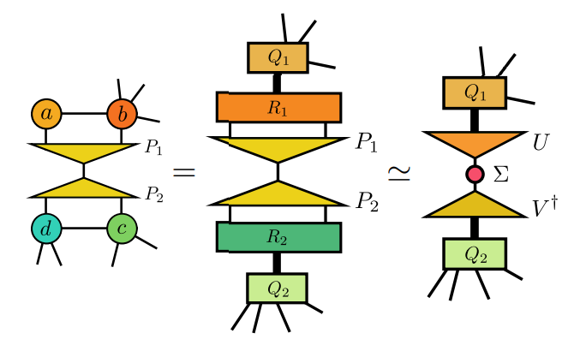

Get $P_{1}$ and $P_{2}$
QR
SVD

Slide 12
AD-VUMPS

Slide 13
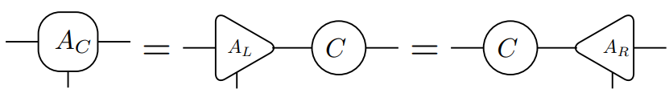
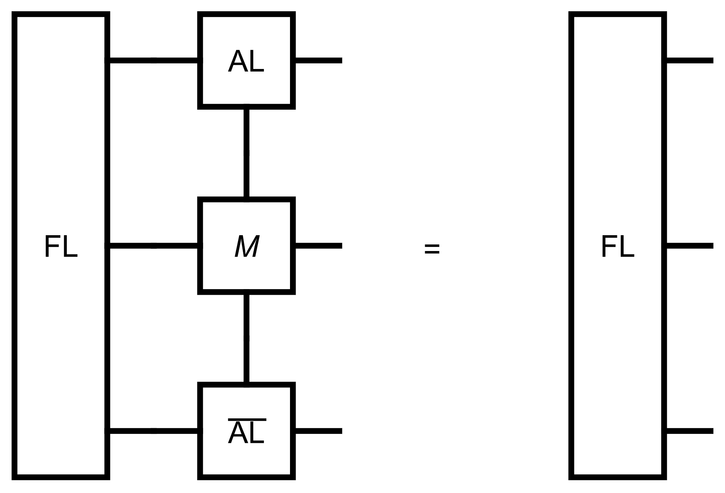
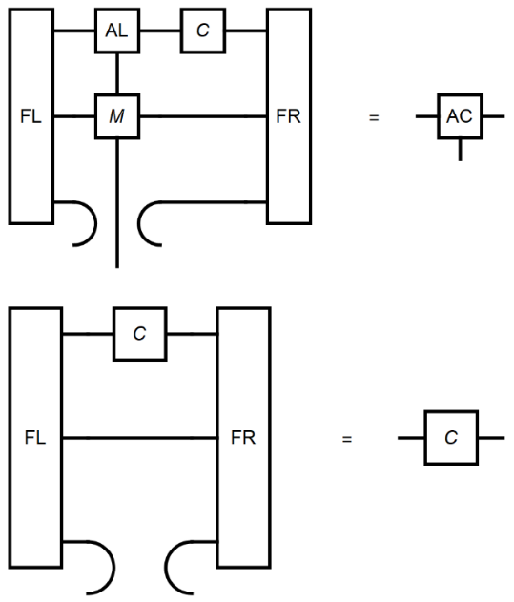
VUMPS-algorithm
# Initial orthonormal form MPS
M = classical2Disingmpo(β; J = 1.0, h = 0.)
AL,C = leftorth (A)
AR = rightorth (AL,C)
while error(AC,FL,FR,M) > tol_error
# Get environment
FL = leftenv(AL, M)
FR = rightenv(AR, M)
# Get orthonormal form
AC, C = vumpsstep(AL, C, AR, M, FL, FR)
# calculate observable
Obs = obser(O, AC, M, FL, FR)

Slide 14
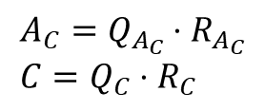
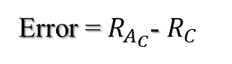
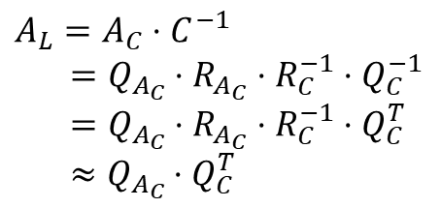

QR to avoid inverse
$$A_{C}=Q_{A_{C}}⋅R_{A_{C}} \\ C=Q_{C}⋅R_{C}$$
$$Q^{T}=Q^{−1}$$
$$A_{L}=A_{C}⋅C^{−1}$$
$=Q_{A_{C}}⋅R_{A_{C}}⋅{R_{C}^{−1}⋅Q}_{C}^{−1}$
$=Q_{A_{C}}⋅R_{A_{C}}⋅{R_{C}^{−1}⋅Q}_{C}^{T}$
$≈Q_{A_{C}}{⋅Q}_{C}^{T}$
Error = $R_{A_{C}}$- $R_{C}$
$$A_{L}^{T}⋅A_{L}=Q_{C}^{ }{⋅Q}_{A_{C}}^{T}⋅Q_{A_{C}}{⋅Q}_{C}^{T}=1$$
inverse and orthogonality at the same time

Slide 15














Computation Graphs
$$FL \\ FR$$
$$C$$
$$AL \\ AR$$
$$FL \\ FR$$
$$β$$
$$M$$
$$O$$
$$AC$$
$$M$$
$$AL AR$$
$$M$$
eigsolve
$$β$$
QR
$$A$$
$$β$$
Repeat until converage

Slide 16











Adjoint of eigsolve
gauge invariant
Only $l$
Only $r$

Slide 17












Adjoint of VUMPS envirment
$$AL$$
$$AL$$
$$FL \\ FR$$
$$M$$
$$M$$
$$AL$$
$$A$$
$\overline{AL}$= $\overline{A}⋅\frac{∂A}{∂AL}$
$\overline{M}$= $\overline{A}⋅\frac{∂A}{∂M}$

Slide 18




Adjoint of QR
Trick: add $δ={10}^{−6}$ to R’s diagonal element for the stability of inverse

Slide 19



2D Classical Ising Model

Slide 20




Finding the Ground State of infinite 2D Heisenberg model
ADVUMPS vs ADCTMRG $D=2 χ=20$ $δ={10}^{−12}$
33.76s vs 15.62s
29.11s vs 15.58s
16.61s vs 4.94s
Difference ~1e-14
Difference ~1e-9
Difference ~1e-9

Slide 21





Problem of D=3
QR isn’t stable for $R^{−1}$
tol=1e-10
tol=1e-20

Slide 22


Problem of iPEPS symmetry
When only require up and down symmetry, Heisenberg(1,1,1)
$E_{0}=−0.85<−0.66$
Vertical and horizontal bond energy should be optimized at the same time

Slide 23
AD-BC-VUMPS

Slide 24


BCVUMPS-algorithm
# Initial orthonormal form MPS
$M_{ij}$ = mpo(params)
${AL}_{ij},C_{ij}$= leftorth ($A_{ij}$)
${AR}_{ij}$ = rightorth (${AL}_{ij},C_{ij}$)
while error(AC,FL,FR,M) > tol_error
# Get environment
AL[i, j] = leftenv(AL[i , :], M [i , :])
AR[i, j]= rightenv(AR[i , :], M [i , :])
# Get orthonormal form
AC[i, j], C[i, j] = vumpsstep(AL[:, j], C[:, j], AR[:, j], M[:, j], FL[:, j], FR[:, j])
# calculate observable
Obs = obser(O, AC, M, FL, FR)

Slide 25

AD for array of array

Slide 26


Be careful of index and replaced function!

